Slide 1
WORKING PAPER V1 · OCTOBER 2026 · UNDER REVIEW
Can Advertising Fund Free AI? Evidence from ChatGPT’s International Advertising Rollout
Organic and paid ChatGPT referrals to 1,898 online shops during the staggered rollout of ads, with the European Union untreated.
Maximilian Kaiser · Christian Schulze
WU Vienna · Frankfurt School of Finance & Management · ecommerceresearch.org/chatgpt-ads
Notes:
This deck presents the working paper "Can Advertising Fund Free AI? Evidence from ChatGPT's International Advertising Rollout" by Maximilian Kaiser and Christian Schulze (version 1, October 2026, under review). It follows the paper section by section and shows all four figures of the main text. Every number on the slides is taken from the paper; the speaker notes give the section and the printed page of the author version where each slide's content is found. Paper: title page and abstract, p. 1.

Slide 2
SECTION 1 · RESEARCH QUESTION
The Advertising Bargain
Condition A: a valuable product
Condition B: valuable ads
Advertising must not substantially diminish the value of the service to users.
If users read organic recommendations as commercially influenced, they may click and buy less often.
We observe the volume and conversion of organic ChatGPT referrals, a proxy for product value.
Advertisements must deliver enough value to advertisers to support the prices the platform needs to charge.
Their returns must be competitive with established channels such as Google Search.
We observe what paid clicks were worth to the websites that bought them.
Working paper v1 · ecommerceresearch.org/chatgpt-ads
02 / 17
Notes:
The research question. Advertising could keep AI assistants free if advertisements do not devalue the product (Condition A) and justify their price (Condition B); the paper follows Moshary (2025) in framing this as a two-sided bargain. Condition A may be particularly difficult for ChatGPT, because the answer is a curated conversational response that can resemble personalized advice rather than a list with visibly separated ads (Hermann, Puntoni, and Schweidel 2026; Salvi, Cuevas, and Horta Ribeiro 2026; Tang et al. 2025). Condition B depends on whether the ads justify their cost, directly through clicks that buy and indirectly through later purchases in other channels (Li and Kannan 2014; Dinner, Van Heerde, and Neslin 2014). Both quantities are normally hidden: the platform does not publish them, and advertisers rarely disclose what their clicks returned. The staggered rollout across nine countries, with the EU untreated, and the traffic and sales data of 1,898 websites let us test both conditions from outside the platform. Paper: Section 1, pp. 1–2.

Slide 3
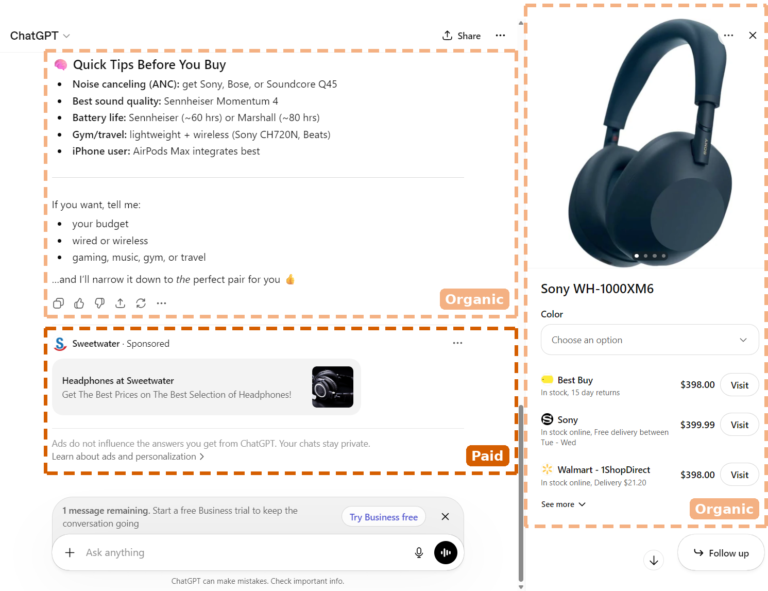
SECTION 1 · FIGURE 1
Ads displayed in ChatGPT (March 2026)
Takeaway: The sponsored card sits below the answer, labeled and visually separated from it.
Shown to free-tier and Go-tier users only.
Organic content: the conversational answer and the product panel with its merchant links.
Separation may protect the organic product, but it may also reduce the effectiveness of the ads.
Independent sampling found ads on about one quarter of commercial US prompts in July (Deda 2026a).
FIG 1 Dashed frames mark organic content versus paid content (the sponsored card). Screenshot by the authors, March 2026.
Working paper v1 · ecommerceresearch.org/chatgpt-ads
03 / 17
Notes:
Figure 1 documents the ad format. The sponsored card (here a headphone retailer) sits below the answer, labeled "Sponsored", with the platform's line that ads do not influence the answers. The design choice matters for both conditions: separation may protect the organic product (Condition A), but separated ads may be less effective (Aribarg and Schwartz 2020), which matters for Condition B. Ads appear on the free and low-priced Go tiers only; Plus and Pro users see none. Paper: Section 1, p. 2; Figure 1, p. 3; Section 2, p. 4.

Slide 4
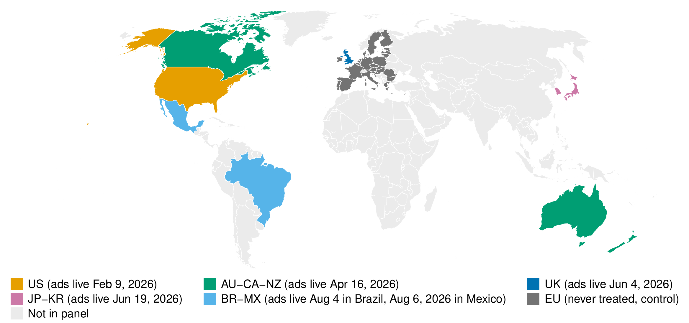
SECTION 2 · ROLLOUT, DATA, AND OUTCOMES · FIGURE 2A
Treated cohorts and the never-treated control block
Takeaway: Ads launched in five cohorts from February 9, 2026; the EU remained untreated throughout our window.
United States: February 9, 2026
Australia, Canada, New Zealand: April 16
United Kingdom: June 4
Japan, Korea: June 19
Brazil, Mexico: August 4 and 6
EU ads went live on August 24, after our window closed
FIG 2A Map of treated cohorts and the untreated EU control block.
Working paper v1 · ecommerceresearch.org/chatgpt-ads
04 / 17
Notes:
Ads launched in the United States on February 9, 2026; in Australia, Canada, and New Zealand on April 16; in the United Kingdom on June 4; in Japan and Korea on June 19; and in Brazil and Mexico on August 4 and 6, respectively. The EU remained untreated throughout: its inclusion was announced on August 15, and EU ads went live only after our window closed, on August 24. Treatment is market-level ad availability. The launch week of a country is the first data week on or after its launch date; launch days before that Monday fall into the pre-launch period, which if anything pulls the estimates toward zero. The opportunity for companies to buy ads expanded from an invitation-only launch to self-service access in May 2026 and to conversion-optimized campaigns in June. Paper: Section 2, pp. 3–4; Figure 2, p. 5; Web Appendix B, pp. 23–25.

Slide 5
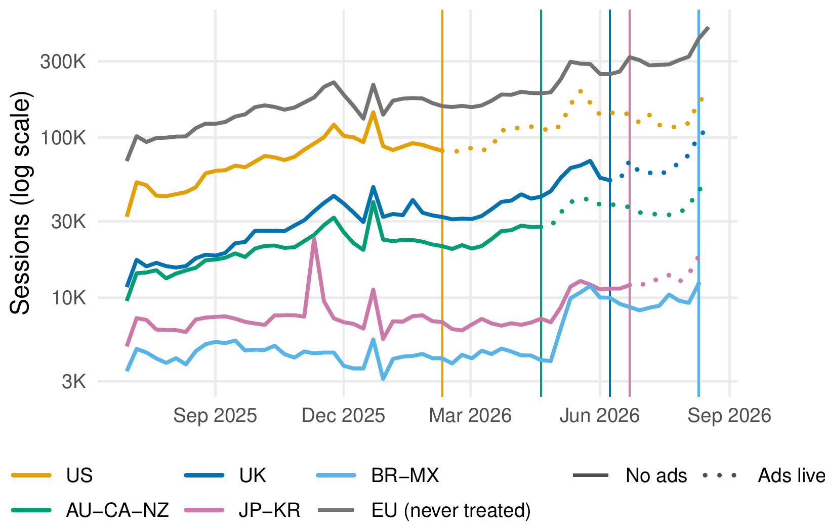
SECTION 2 · ROLLOUT, DATA, AND OUTCOMES · FIGURE 2B
Weekly organic ChatGPT referrals
Takeaway: Organic ChatGPT accounted for 0.23% of all visits over the full window and 0.40% over its final four weeks.
Vertical lines mark launch weeks; the segments after each launch are dotted.
The never-treated EU is the control block for every rollout cohort.
Paid ChatGPT: 0.007% of visits over the full window and 0.030% over its final four weeks.
FIG 2B Weekly organic ChatGPT referral sessions to the organic referral panel by region group, log scale.
Working paper v1 · ecommerceresearch.org/chatgpt-ads
05 / 17
Notes:
Panel B shows the raw series behind Condition A: weekly organic ChatGPT referral sessions by region group, before and after each launch, with the EU as the never-treated block. The channel kept growing in every region, which is why the design compares changes in launch countries with changes in the EU rather than before with after. Over the full window, organic ChatGPT accounted for 0.23% of all visits and 0.40% over the window's final four weeks; on the paid referral panel, paid ChatGPT sessions accounted for 0.007% of all visits over the full window and 0.030% over its final four weeks. Shares are of all sessions from every source (Table C.1). Paper: Section 2, p. 4; Figure 2, p. 5; Web Appendix C, pp. 26–30.

Slide 6
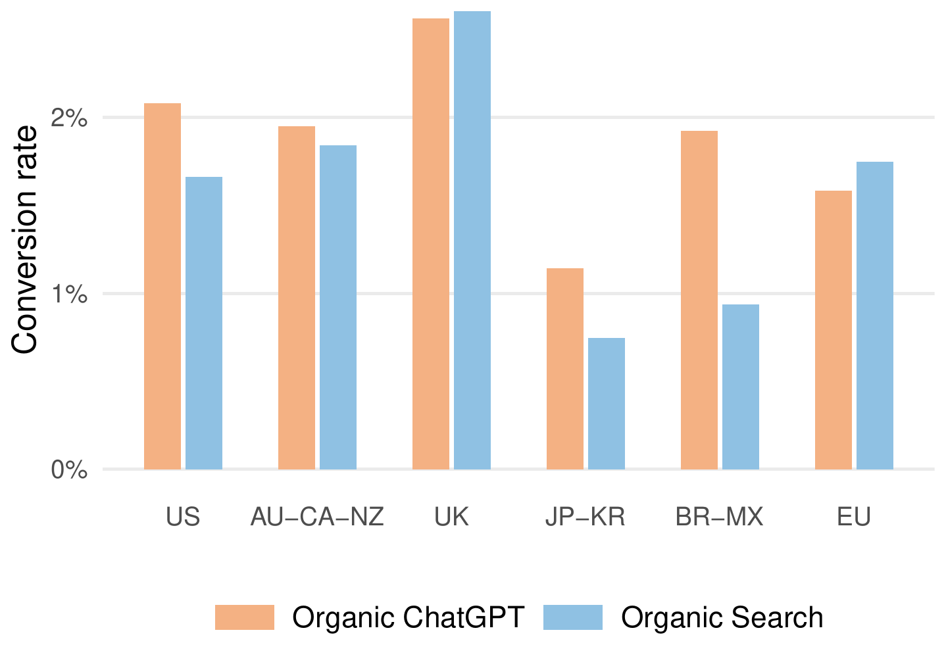
SECTION 2 · ROLLOUT, DATA, AND OUTCOMES · FIGURE 2C
Data: 60 weeks, nearly 10 billion visitor sessions
Takeaway: Before the rollout, organic ChatGPT’s conversion rate approximately matched organic search’s.
June 29, 2025, to August 22, 2026, by website, country, device, channel, and week.
Condition A: 1,898 websites, 22.4 million organic ChatGPT referrals.
Condition B: 387 websites, 0.45 million paid ChatGPT referrals; 102 with financial tracking, 31 with costs.
Last click only: no prompts, ad impressions, or subscription tiers.
FIG 2C Conversion rates of organic ChatGPT and organic search referrals over each region’s pre-rollout period; for the EU, the period before February 9, 2026.
Working paper v1 · ecommerceresearch.org/chatgpt-ads
06 / 17
Notes:
The data is Google Analytics 4 e-commerce records of the panel websites, provided free of charge by Grips Intelligence, which had no role in the research questions, design, analysis, interpretation, or drafting. The organic referral panel of 1,898 websites sells about $16 billion a year. The paid referral panel of 387 websites contains the financial sample of 102 websites with complete financial tracking, and the cost sample of 31 of those 102 with linked Google Ads records. Organic ChatGPT converted at 1.99% over the full window. Panel C shows that before the rollout it had closed the conversion gap to organic search that Kaiser and Schulze (2026) documented for the channel's first year. The data captures the last click that brought a visitor to a website; it does not reveal prompts, recommendation sets, ad impressions, or subscription tiers. Disclosure: Maximilian Kaiser was previously employed by Grips Intelligence and now serves as its scientific advisor; Christian Schulze declares no competing interests. Paper: Section 2, p. 4; Figure 2, p. 5; Funding and Competing Interests, p. 14; Web Appendices A to C, pp. 21–31.

Slide 7
DESIGN · SECTIONS 3 AND 4, WEB APPENDIX O
What we estimate
Condition A: causal, the staggered rollout
Condition B: descriptive, against paid search
Organic ChatGPT referrals against Google’s organic search, within each website, market, device, and week.
Every rollout cohort against the never-treated EU (Sun–Abraham estimator).
Volume: Poisson model of session counts. Conversion: rate difference, weighted at pre-launch levels.
Intention-to-treat effect of ad availability; standard errors clustered by website.
Advertiser entry is self-chosen, not randomized.
Benchmark: paid Google Search, which the same websites already buy for similar commercial intent.
Channels compared with direct traffic, adjusted for website-by-device and device-by-week effects.
Parity price: the price at which a ChatGPT click returns as much per dollar as a search click.
Working paper v1 · ecommerceresearch.org/chatgpt-ads
07 / 17
Notes:
The design in plain words. Condition A compares two changes: the change in launch countries against the change in the untreated EU, and organic ChatGPT referrals against organic search referrals to the same website. Factors that affect an online shop or market as a whole cancel out, and same-week comparisons across countries remove common shocks from model releases, competing products, and publicity. The Sun–Abraham estimator keeps already-treated cohorts from serving as controls. Weeks without ChatGPT referrals count as zeros in the volume model rather than dropping out. Estimates are expressed against the pooled pre-launch average of the cohorts rather than a single reference week. Condition B is descriptive rather than causal: it shows the observed outcomes of sessions in each channel, not what an advertiser would have earned by buying one channel instead of another. Paper: Section 3, pp. 5–6; Section 4, p. 9; Web Appendices D, E, J, and O (pp. 32–38, 53–57, 67–68).

Slide 8
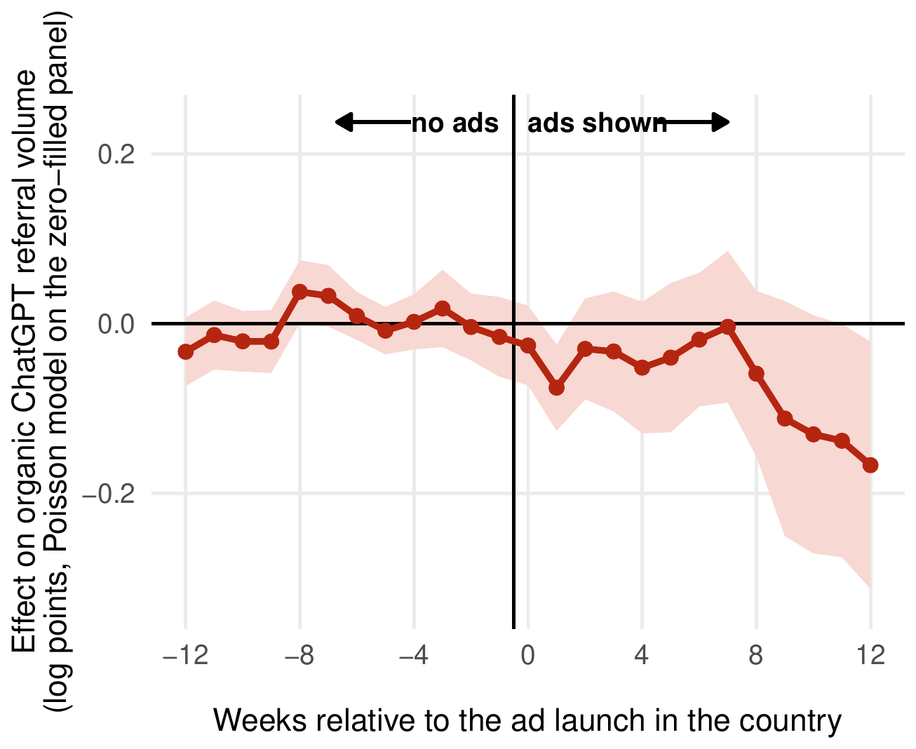
SECTION 3 · CONDITION A · FIGURE 3A
After the introduction of ads, organic referral volume fell by 6 to 8%
Takeaway: −5.9% over the first 13 post-launch weeks; −7.2% to −8.4% allowing for faster usage growth outside Europe.
95% interval from −12.6% to +1.2% (p = .103).
Declines at least this large arose in 10 of 100 placebo rollouts.
With the 12% (6%) growth differential: −8.4% (−7.2%), p = .019 (p = .045).
FIG 3A Organic ChatGPT referral volume, Poisson model of session counts: Sun–Abraham event study with website-clustered 95% intervals.
Working paper v1 · ecommerceresearch.org/chatgpt-ads
08 / 17
Notes:
Organic referral volume changed by −5.9%, averaged over the first 13 post-launch weeks, with a 95% interval from −12.6% to +1.2% (p = .103; Table F.1). Declines at least this large arose in 10 of 100 placebo rollouts among untreated European countries (Table F.2). Both the interval and the placebo test indicate a decline, but neither establishes it with confidence. These estimates would understate the decline if ChatGPT usage in the treated markets had grown faster than in Europe. OpenAI's regional adoption index suggests that North America outgrew Europe by about 6% in the year before the launch and by about 12% per year over our window. Including the 12% (6%) differential moves the estimate to −8.4% (−7.2%), with 95% intervals from −14.9% to −1.5% (−13.8% to −0.2%) and p = .019 (p = .045); declines of that size arose in 4 (8) of the 100 placebo rollouts (Web Appendix G). In summary, the analyses suggest that the introduction of ads moderately reduced organic referrals, by about 6 to 8% relative to untreated markets. Paper: Section 3, pp. 6–7; Figure 3, p. 8; Tables F.1 and F.2; Web Appendix G, pp. 46–47.

Slide 9
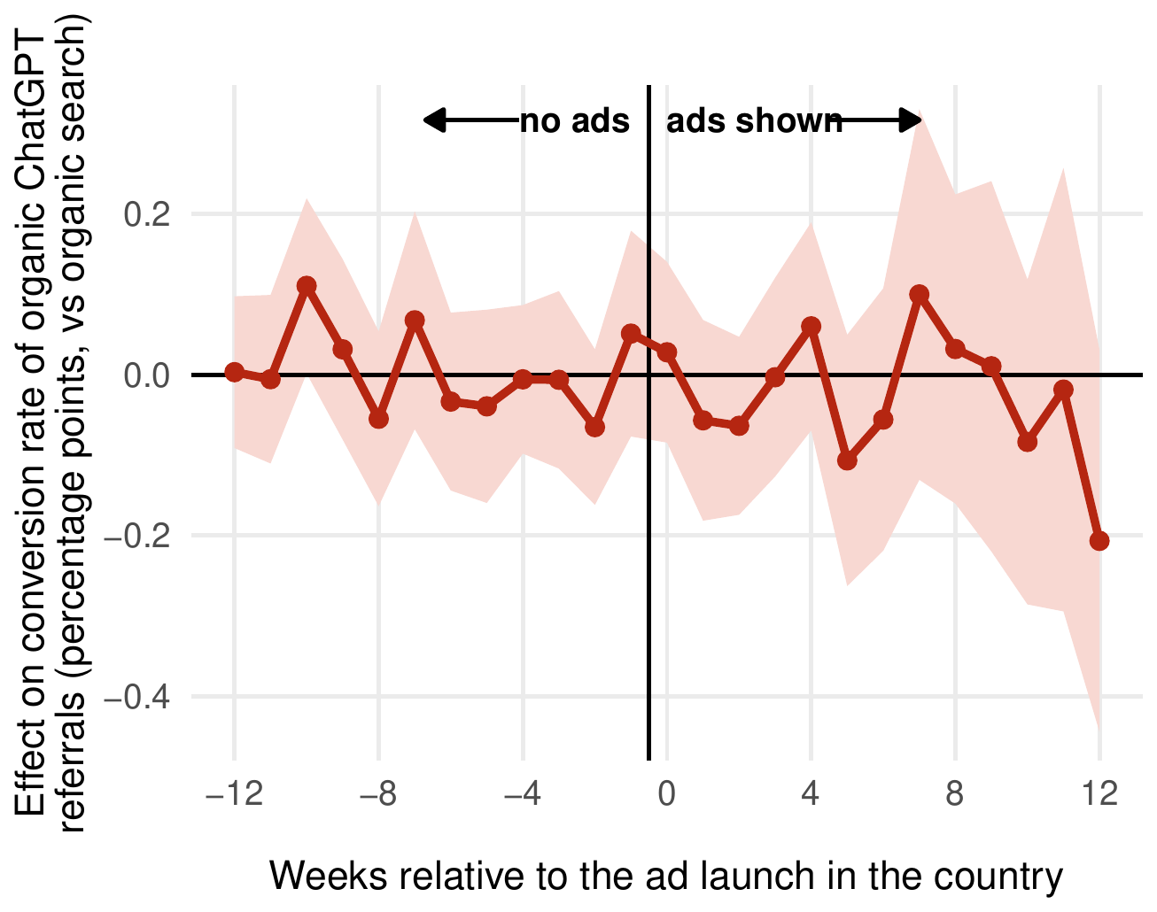
SECTION 3 · CONDITION A · FIGURE 3C
Visitors who still arrived converted as before
Takeaway: Conversion changed by −0.02 percentage points from a 2.21% pre-launch baseline.
Standard error of 0.05 percentage points: a decline of about 1%.
Declines at least this large arose in 187 of 500 placebo rollouts.
Ruled out: an immediate average decline larger than 6% (interval) or 10% (placebo) of baseline.
FIG 3C Conversion rate of organic ChatGPT versus organic search referrals, weighted at pre-launch levels: Sun–Abraham event study, 95% intervals.
Working paper v1 · ecommerceresearch.org/chatgpt-ads
09 / 17
Notes:
Organic ChatGPT conversion changed by −0.02 percentage points from a 2.21% pre-launch baseline, with a standard error of 0.05 percentage points (p = .648; Table F.3), a decline of about 1% whose interval comfortably includes zero. Declines at least this large arose in 187 of 500 placebo rollouts (Table F.2). The 95% interval and the placebo distribution rule out an immediate average decline larger than 6 and 10% of baseline, respectively (Table H.1). Changes in the customer base have little room to explain this stability: because referral volume fell at most moderately, conversion is measured on nearly the same visitors as before. If conversion is read as a proxy for trust in ChatGPT's advice, the introduction of ads left that trust intact in the early rollout. Paper: Section 3, p. 7; Figure 3, p. 8; Section 3 summary, p. 9; Tables F.2, F.3, H.1.

Slide 10
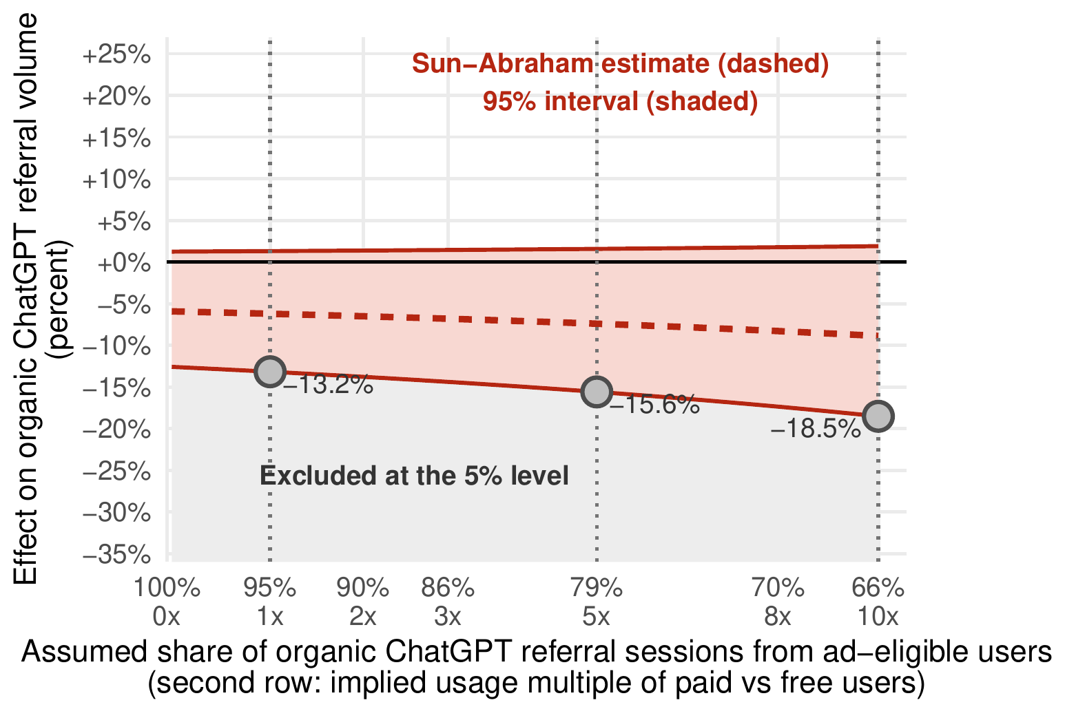
SECTION 3 · CONDITION A · FIGURE 3B
Per eligible user, the bounds are wider: referral volume
Takeaway: If ad-eligible users account for 79% (66%) of sessions, volume falls by at most 16 to 19% (19 to 23%).
Plus and Pro users see no ads: about 5% of users, using ChatGPT three to eleven times as much as free users.
Ruled out at the 5% level: declines beyond −13.2%, −15.6%, and −18.5%.
Dropping the United States cohort leaves volume at −5.8%.
FIG 3B Volume estimate as the share of sessions from ad-eligible users falls from 100% to 66%; markers at one, five, and ten times the free users’ usage.
Working paper v1 · ecommerceresearch.org/chatgpt-ads
10 / 17
Notes:
Users on the Plus and Pro tiers see no ads. These paying users are only about 5% of users but use ChatGPT three (Plus) to eleven (Pro) times as much as free users; if they average five (ten) times as much, users eligible for ads account for about 79% (66%) of referral sessions. Dividing the market-level bounds by that share gives the bounds for eligible users: at most 16 to 19% (19 to 23%) decline in volume. In panel B the 5%-level bound on volume is −13.2%, −15.6%, and −18.5% at one, five, and ten times the free users' usage. Robustness (pp. 7–8): the joint pre-trend test for volume gives p = .109 (Table I.1); dropping the United States cohort leaves volume at −5.8%; dropping the largest websites, individually or the ten largest together, keeps volume between −5.1% and −8.8%. Paper: Section 3, pp. 7–8; Figure 3, p. 8; Table H.1; Web Appendix H, pp. 48–50.

Slide 11
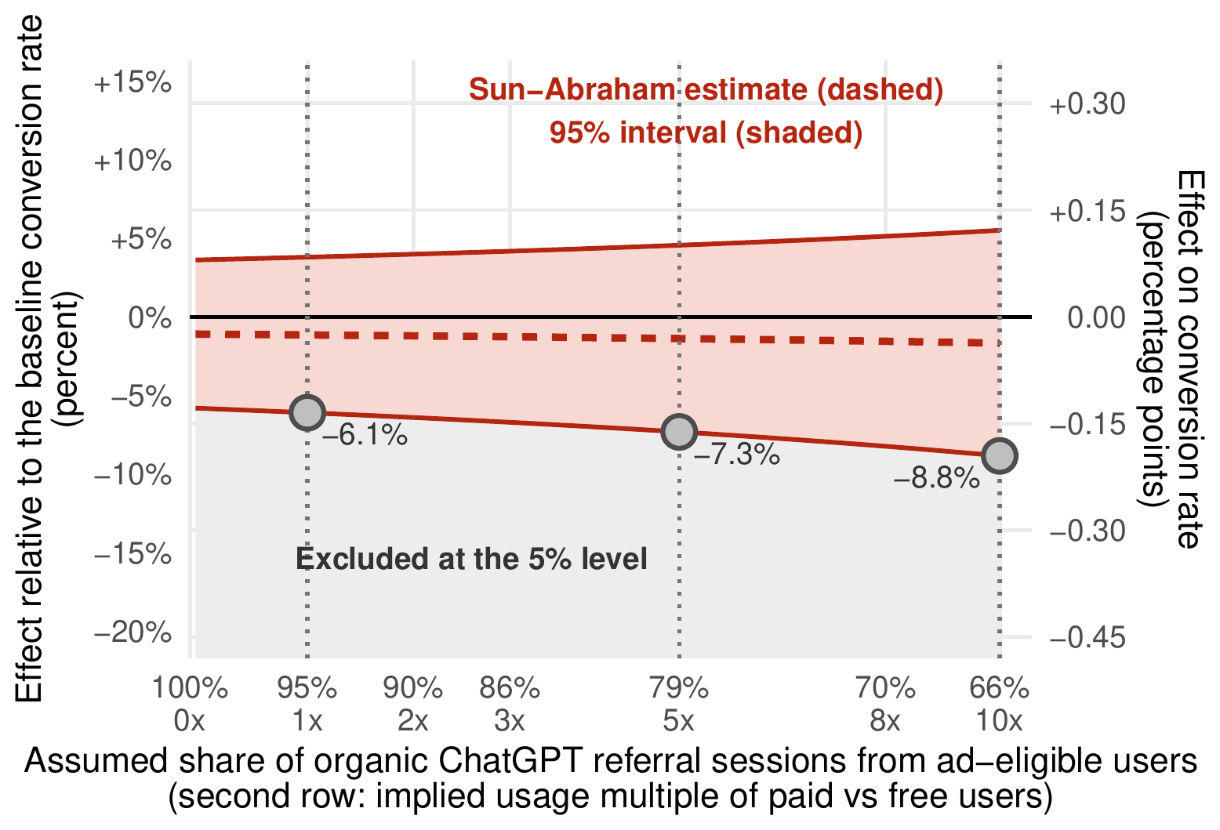
SECTION 3 · CONDITION A · FIGURE 3D
Per eligible user, the bounds are wider: conversion rate
Takeaway: If ad-eligible users account for 79% (66%) of sessions, conversion falls by at most 7 to 12% (9 to 15%).
Ruled out at the 5% level: declines beyond −6.1%, −7.3%, and −8.8% of baseline.
Joint pre-trend test for conversion: p = .458.
Dropping any single country moves conversion by at most 0.02 percentage points.
FIG 3D Conversion estimate relative to the 2.21% baseline as the assumed share of sessions from ad-eligible users falls from 100% to 66%; right axis in percentage points.
Working paper v1 · ecommerceresearch.org/chatgpt-ads
11 / 17
Notes:
The same calculation for conversion: dividing the market-level bounds by the 79% (66%) share of sessions from ad-eligible users gives at most a 7 to 12% (9 to 15%) decline in conversion for eligible users. In panel D the conversion bound is −6.1%, −7.3%, and −8.8% of the 2.21% baseline at one, five, and ten times the free users' usage. Robustness (pp. 7–8): joint pre-trend tests give p = .458 for conversion (Table I.1); the test on the United Kingdom's conversion path alone gives p < .001, but removing that country moves the pooled estimate by only a hundredth of a percentage point; dropping the United States cohort leaves conversion at −0.003 percentage points, and dropping any other single country moves it by at most 0.02 percentage points. Paper: Section 3, pp. 7–8; Figure 3, p. 8; Table H.1; Web Appendix H, pp. 48–50.

Slide 12
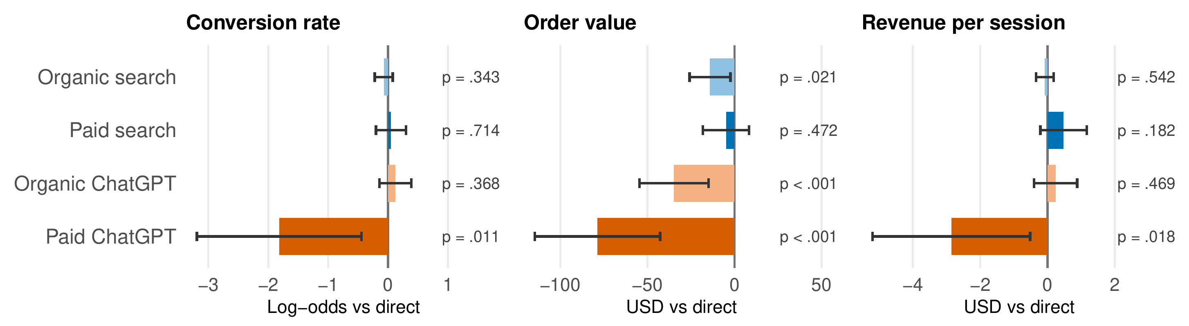
SECTION 4 · CONDITION B · FIGURE 4A–C
Paid ChatGPT trails direct traffic on every metric
Takeaway: Paid ChatGPT converts far less often (log-odds −1.82), with orders $79 smaller and $2.86 less revenue per session than direct traffic.
FIG 4A–C Conversion rate (log-odds), average order value (USD), and revenue per session (USD), 102 advertisers of the financial sample: differences versus direct traffic, adjusted for website-by-device and device-by-week effects, with 95% intervals. Paid search does not differ detectably from direct traffic on any of the three.
Working paper v1 · ecommerceresearch.org/chatgpt-ads
12 / 17
Notes:
Figure 4 places both ChatGPT channels among the websites' established channels, each measured against direct traffic, adjusted for website-by-device and device-by-week effects. Among the 102 advertisers of the financial sample, paid ChatGPT visitors convert far less often (log-odds −1.82, p = .011), place orders $79 smaller (p < .001), and generate $2.86 less revenue per session (p = .018). Google's paid search, by contrast, does not differ detectably from direct traffic on any of the three (p = .714, .472, and .182). Organic ChatGPT also does not differ detectably from direct traffic on conversion (p = .368) or revenue per session (p = .469). Paper: Section 4, pp. 9–10; Figure 4, p. 10; Table J.1, p. 57.

Slide 13
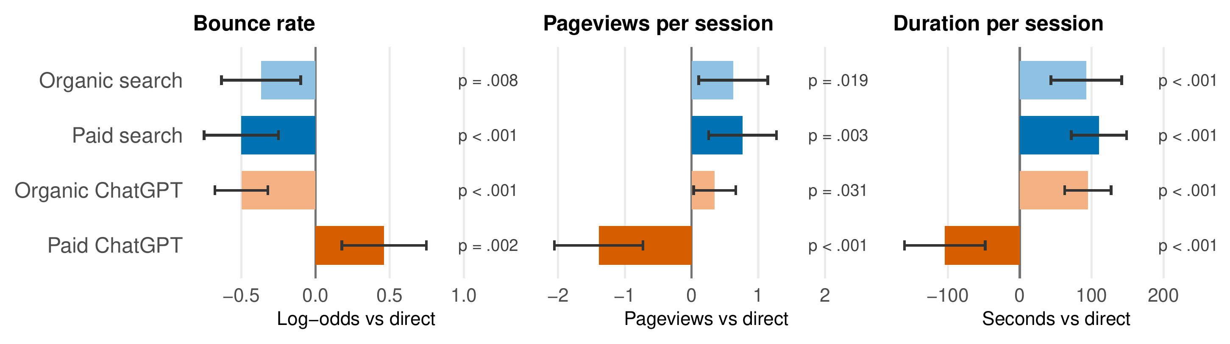
SECTION 4 · CONDITION B · FIGURE 4D–F
Paid ChatGPT visitors show weaker engagement
Takeaway: Paid ChatGPT visitors bounce more often (log-odds +0.46), view 1.4 fewer pages, and stay 104 seconds less than direct visitors.
FIG 4D–F Bounce rate (log-odds), pageviews per session, and duration per session (seconds), paid referral panel of 387 websites: differences versus direct traffic with 95% intervals. Paid ChatGPT is the only channel that falls short of direct traffic on all six metrics of Figure 4.
Working paper v1 · ecommerceresearch.org/chatgpt-ads
13 / 17
Notes:
On the larger paid referral panel of 387 websites, paid ChatGPT visitors bounce more often (log-odds +0.46, p = .002), view 1.4 fewer pages (p < .001), and stay 104 seconds less (p < .001) than direct visitors. Paid search, organic search, and organic ChatGPT visitors all bounce less, view more pages, and stay longer (panels D to F; largest p = .031). Paid ChatGPT is the only channel that falls short of direct traffic on all six metrics of Figure 4. Paper: Section 4, p. 10; Figure 4, p. 10; Table K.2, p. 61.

Slide 14
SECTION 4 · CONDITION B · US TRAFFIC, FINANCIAL SAMPLE
Paid ChatGPT visits generated less value for advertisers than paid search
$0.89
0.37%
$0.26
vs $2.45
vs 1.17%
vs $1.72
revenue per session: a 64% shortfall
conversion rate
parity price per click vs the largest publicly known account’s price
Paid ChatGPT vs paid Google Search, 102 advertisers of the financial sample. Within the same shops: conversion −1.87 log-odds (p = .005), orders $74 smaller (p < .001); 97% of the 87 dual-channel advertisers earn less per ChatGPT visit. Parity price at the median paid-search click of $0.72.
Working paper v1 · ecommerceresearch.org/chatgpt-ads
14 / 17
Notes:
In US traffic, where ad delivery concentrated, a paid ChatGPT visit generates $0.89 in revenue per session against $2.45 for a paid Google Search visit, a 64% shortfall. Paid ChatGPT visitors buy less often (conversion rates of 0.37% versus 1.17%; adjusted difference −1.87 log-odds, p = .005; Table J.1), and their orders are smaller, by $74 (p < .001). Among the 87 dual-channel advertisers, 97% earn less per ChatGPT visit and 98% convert worse. Most websites make no sale from ChatGPT ads at all: 84% record no paid ChatGPT transaction despite 18,726 paid ChatGPT sessions, and the remaining 14 websites carry all 570 transactions (Table K.1). Parity price: a paid-search click returns $2.45 on average and costs the US-focused advertisers of our cost sample a median of $0.72. A paid ChatGPT visit returns $0.89 and is therefore worth about $0.26 at the same rate of return (between $0.05 and $0.57 when advertisers are resampled). The largest publicly known account paid $1.72 per ChatGPT click (Opascope 2026), more than six times the parity price; that price sits below the recommended starting bid of $3 to $5 per click. Two caveats apply: the parity price assumes similar profit margins in both channels, and it counts only the tracked visit. Matched comparisons around each advertiser's first paid week find no detectable lift in the channels the campaigns did not buy (Table N.1). Paper: Section 4, pp. 9 and 11–12; Tables J.1, K.1, N.1; Web Appendix L, p. 62.

Slide 15
FINDINGS · SECTIONS 3 TO 5
What we find in our sample
Condition A: moderately fewer organic referrals, unchanged conversion
Condition B: advertiser value remains unproven
Volume: −5.9% over the first 13 post-launch weeks against the untreated EU; −7.2% to −8.4% allowing for faster usage growth.
Conversion: −0.02 percentage points from a 2.21% baseline (p = .648).
1,898 websites; 60 weeks to August 22, 2026.
Revenue per session (US): $0.89 for paid ChatGPT against $2.45 for paid search.
Parity price about $0.26 per click; the largest publicly known account paid $1.72.
387 websites, 102 with financial tracking, 31 with costs; the first 28 weeks of advertising.
Working paper v1 · ecommerceresearch.org/chatgpt-ads
15 / 17
Notes:
The findings in one slide, each with its comparison, sample, and period. Condition A: in the early rollout, the observed damage was moderate. Ads cost ChatGPT about 6 to 8% of its organic referrals relative to untreated markets (95% interval −12.6% to +1.2% before the growth adjustment), and the visitors who still arrived converted as before. The organic referral panel covers 1,898 websites over 60 weeks from June 29, 2025, to August 22, 2026, with five rollout cohorts in nine countries. Because observed ad activity concentrated in the United States and United Kingdom, the pooled estimates describe the early rollout rather than five equally intense rollout cohorts. Condition B: in the first 28 weeks of advertising, a paid ChatGPT visit returned about a third of a paid-search visit's value at about 2.4 times its price; taken together, ChatGPT ads offer more than six times worse value for money than Google Search ads in our data. Only one (small) advertiser in 102 matches the public account's conversion and revenue per visit (Table N.2). No single advertiser drives the shortfall: across the 102 leave-one-out re-estimates, the largest p-value is .015 for conversion and .007 for revenue per session. Paper: Section 3 summary, p. 9; Section 4 summary, pp. 11–12; Section 5, p. 12.

Slide 16
SCOPE AND LIMITS · WEB APPENDIX O
What the data can show
Treatment is market-level ad availability, not an individual user’s exposure to an ad.
Without the usage-growth adjustment, the volume interval includes zero (p = .103).
Ad activity concentrated in the United States and United Kingdom: the estimates describe the early rollout.
Condition B is descriptive: advertiser entry is self-chosen, and campaigns that never produced a click are invisible.
The parity price assumes similar profit margins in both channels and counts only the tracked visit.
What we do not observe
Prompts, recommendation sets, ad impressions, subscription tiers, and behavior inside ChatGPT. Neither outcome measures user trust directly.
Working paper v1 · ecommerceresearch.org/chatgpt-ads
16 / 17
Notes:
The limits, stated once. Condition A is causal under the assumptions of Web Appendix D: it is an intention-to-treat effect of the introduction of ads in a country, measured against the untreated EU and against organic search to the same website. Estimates measure the effect of making ads available in a market, not the effect on an individual known to have seen one. The volume decline is not established with confidence without allowing for faster usage growth outside Europe; the interval excludes zero once the growth differential exceeds about 5% per year. Pre-trend tests have little power against a smooth growth differential. Condition B shows observed outcomes of sessions in each channel, not what an advertiser would have earned by buying one channel instead of another. First-click dates can lag true campaign starts, and the cross-channel intervals rule out only large indirect effects. The matched comparisons at entry can show patterns consistent with additional traffic but cannot separate it from selection. The financing arithmetic of the Discussion is illustrative calculation under stated assumptions, not an estimate from the rollout and not a prediction (Web Appendix P). Paper: Section 2, p. 4; Section 3, pp. 6–8; Section 4, pp. 9–11; Web Appendix O, pp. 67–68.

Slide 17

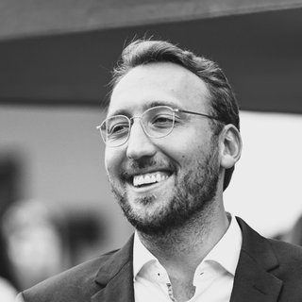

PAPER, SLIDES AND UPDATES
ecommerceresearch.org/chatgpt-ads
The working paper, the full text, these slides, and updates by email.
Scan: ecommerceresearch.org/chatgpt-ads
Maximilian Kaiser
Christian Schulze
WU Vienna (Vienna University of
Economics and Business)
Frankfurt School of
Finance & Management
research@maximiliankaiser.org
email@christian-schulze.de
LinkedIn
LinkedIn
How to cite
Kaiser, M., & Schulze, C. (2026). Can Advertising Fund Free AI? Evidence from ChatGPT’s International Advertising Rollout. Working paper, version 1, October 2026.
Figures are the authors’ own, reproduced from the working paper. The paper is under review; results may change in later versions.
Notes:
Please cite the working paper as shown. The companion site, ecommerceresearch.org/chatgpt-ads, carries the working paper, the full text, the latest version of these slides, and updates by email; the QR code leads there. Contact: Maximilian Kaiser (WU Vienna), research@maximiliankaiser.org; Christian Schulze (Frankfurt School of Finance & Management), email@christian-schulze.de. Related work by the same authors: Kaiser and Schulze (2026), "Frontiers: ChatGPT Referrals to E-Commerce Websites: How Do LLMs Compare Against Traditional Channels?", Marketing Science, 45 (4), 699–715.

